Slide 1
Using Git
With GitBash / CLI (Command Line Interface)
Available anywhere Git is installed!
Creating a new Project Repository
Sharing the Repository with the instructor(s)
Downloading Repository from server to harddrive
Adding new files
Creating a commit
Pushing to/Syncing with the server
Pulling new changes

Slide 2
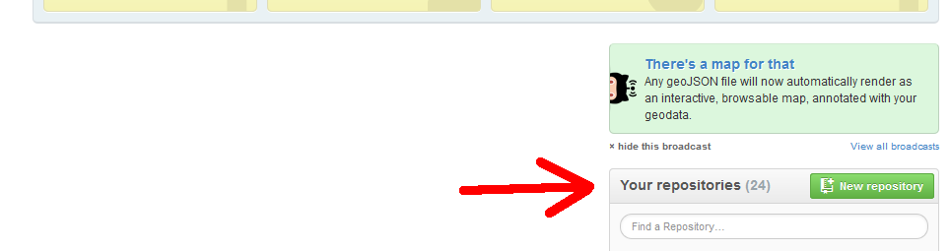
1. Creating a new Project Repository
From https://github.com/, scroll down until you see the green New repository button under the Your repositories section. Click the button.

Slide 3
1. Creating a new Project Repository
On the Create a New Repository page, fill out the following:
  Repository Name: CS201
  Description: Optional
  Select Private radio button
    If it asks for a credit card, you haven't been activated as a student account yet. See week 1 slides
  Check Initialize this repository with a README
  From the dropdown box, select C++ as the language

Slide 4
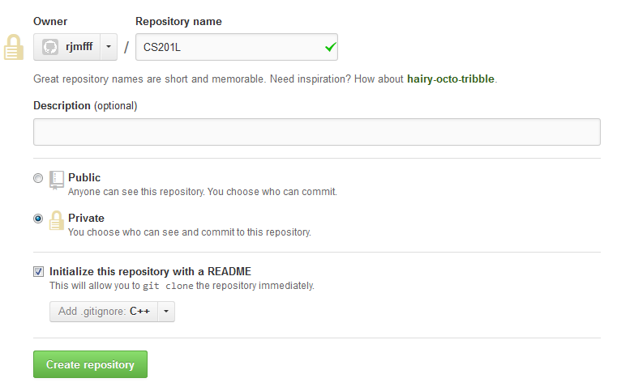
1. Creating a new Project Repository

Slide 5
1. Creating a new Project Repository
You will need to create an additional repository if you're in the CS 201 Lab.
  CS 201
  CS 201 L

Slide 6
2. Sharing your Repositories
For CS 201, you will need to share your repository with Rachel.
For CS 201 L, you will need to share your repository with Imrul and Rachel.

Slide 7
2. Sharing your Repositories
From your Repository website,
https://github.com/YOUR_USERNAME/CS201
Click on the Settings button.

Slide 8
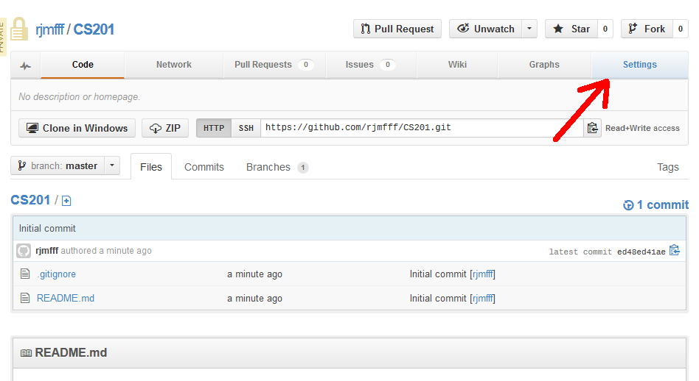
2. Sharing your Repositories

Slide 9
2. Sharing your Repositories
From the Settings page, click on the Collaborators tab.
In the Collaborators tab, enter our IDs:
  RJMFFF for Rachel (CS 201 and CS 201 L)
  Simrul for Imrul
  Usernames are not case-sensitive
Click on the Add button.

Slide 10
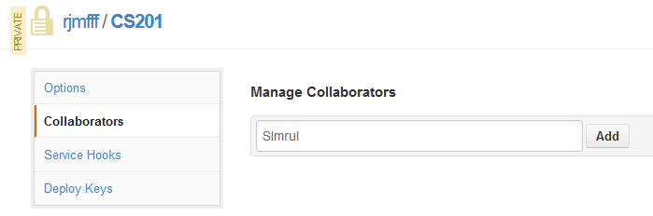
2. Sharing your Repositories

Slide 11

3. Setting up Git
If you have GitHub for Windows/Mac installed or GitGUI installed, then you are able to use Git from the Command Line as well!
CLI stands for “Command Line Interface”.
Open:
  Git Bash from the Start Menu (Windows)
  Open a terminal (*NIX)

Slide 12
4. Downloading your Repository
The repository is currently only on the web server. To add and change files, you need to pull it down to your local machine.
You will modify files on your harddrive, and when you're done with a change, push them back to the server.

Slide 13
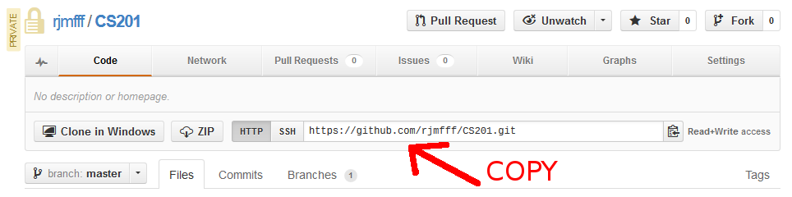
4. Downloading your Repository
From your Repository website,
https://github.com/YOUR_USERNAME/CS201
highlight the .git URL and copy it.

Slide 14
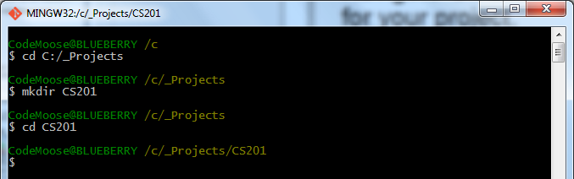
4. Downloading your Repository
Navigate Git Bash or your terminal to a folder for your project.

Slide 15
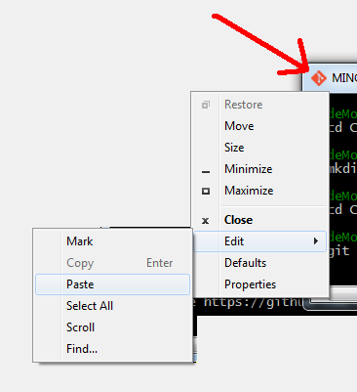
4. Downloading your Repository
Type “git clone”, then paste in the .git URL.
In GitBash, you can paste by clicking on the program icon, clicking Edit, then Paste.
Hit enter.

Slide 16
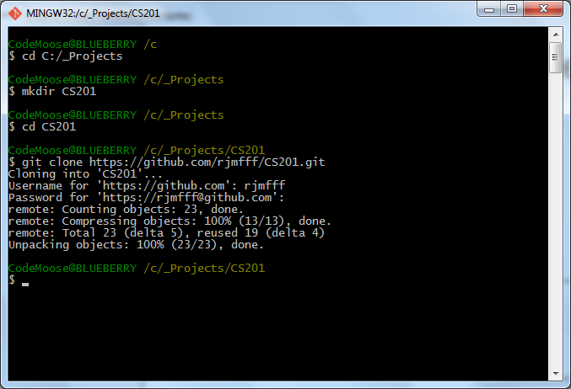
4. Downloading your Repository

Slide 17
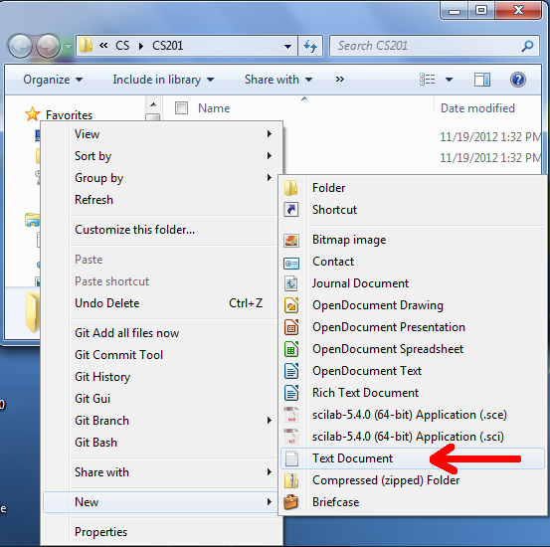
5. Adding a test file
Navigate to your project folder in Windows Explorer (or whatever).
Create a new text document in the repository folder.

Slide 18
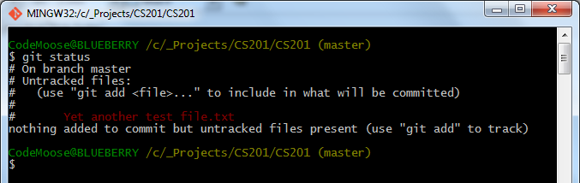
5. Adding a test file
From Git Bash, type:
git status
This tells you what files have been changed.

Slide 19
5. Adding a test file
You can add a specific file by typing:
git add [filename]
Or add all changes by typing:
git add *
If you type the first few characters of a filename and hit TAB, it will try to autocomplete for you.
If there are spaces in the filename, you need to prefix the spaces with \ or include the filename within double-quotes.

Slide 20
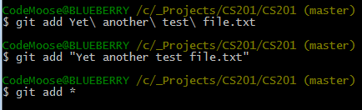
5. Adding a test file
Use git add to add the new file.

Slide 21
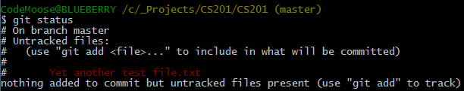
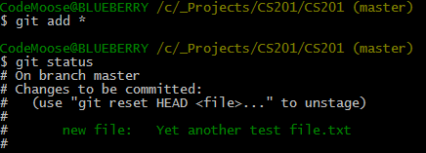
5. Adding a test file
git status before add:
git status after add:

Slide 22
5. Adding a test file
Now we need to commit the file we added. A commit can contain multiple files and has a label message so you can keep track of your changes over time.
You can commit with either:
git commit
or
git commit -m "This is my commit message"

Slide 23
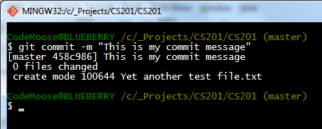
5. Adding a test file
If you use git commit (without the -m flag), your OS will open a text editor for you to add the commit message.
If it opens Vim... well, I don't know how to use Vim. Close the bash and commit with the -m flag. :P

Slide 24
6. Pushing your changes to the server
Now we've committed our changes, but it isn't backed up to the server until we actually push the changes.
To push our list of commits to the server, use
git push -u origin master
Don't worry about what “-u origin master” means for this class, just memorize it.
(It has to do with branching).

Slide 25
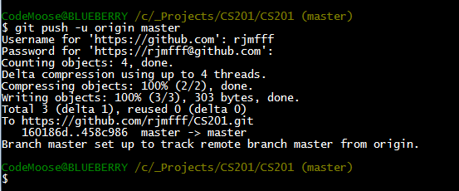
6. Pushing your changes to the server

Slide 26
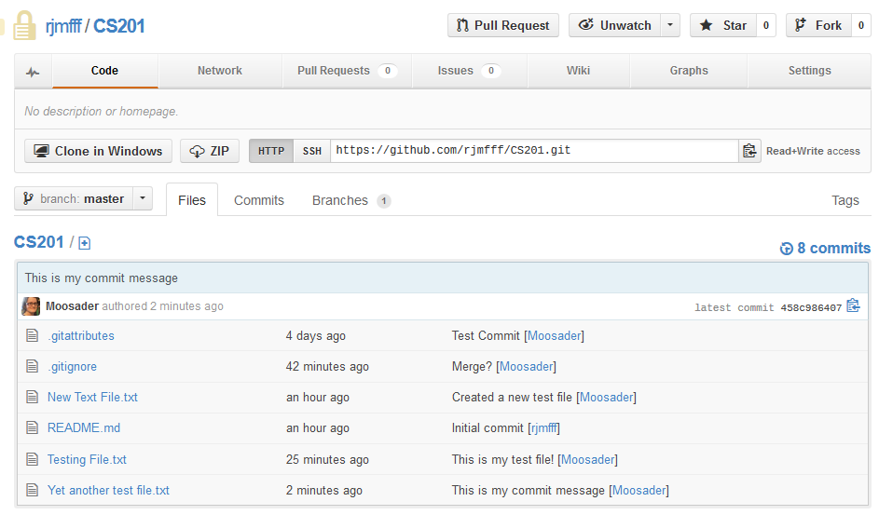
6. Pushing your changes to the server
Your changes will now be visible on the webpage.

